Slide 1

Project Presentation On
Train Ticket Reservation System

Slide 2
PRESENTED BY:
KAPIL AGRAWAL
MUSKAN GUPTA
KERKERE MALLIKARJUN
MADHU RAMESH
SARIM RIZVI

Slide 3
OBJECTIVE
The developed application consist registration page where passenger can register and login.
Passenger will be able to get train details.
User will get the passenger details options.
User will get the payment options.
User will get ticket booking confirmation with ticket print.

Slide 4
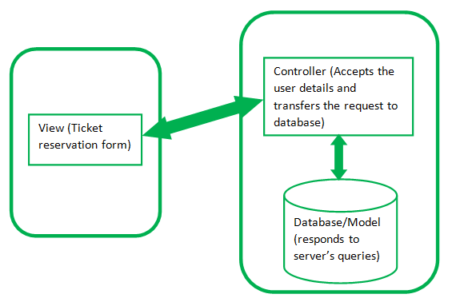
MVC ARCHITECTURE

Slide 5
Tools & Technologies Used:
JDK
Eclipse
MySQL Workbench
Visual Studio Code
Java
Maven Framework
JDBC framework
Spring Framework
MySQL
HTML
CSS
JavaScript
jsp

Slide 6
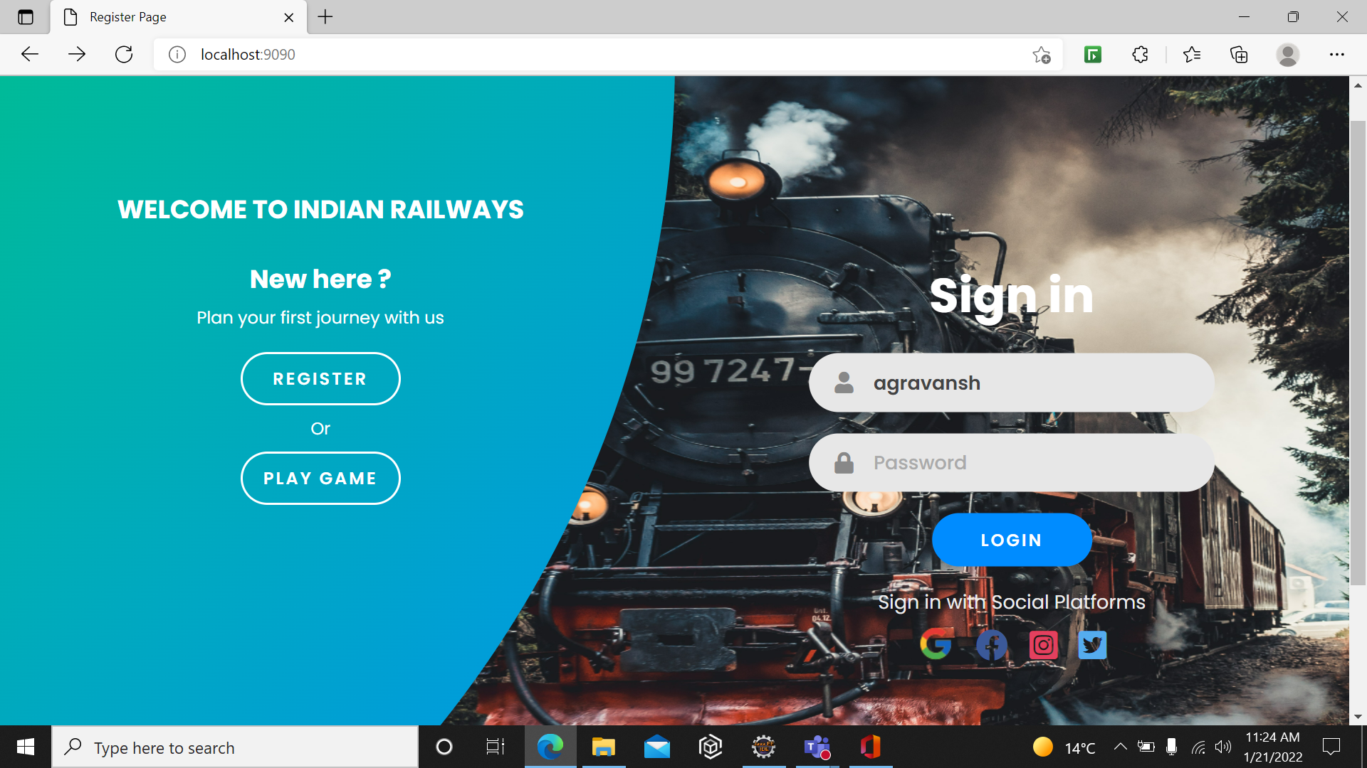

Slide 7
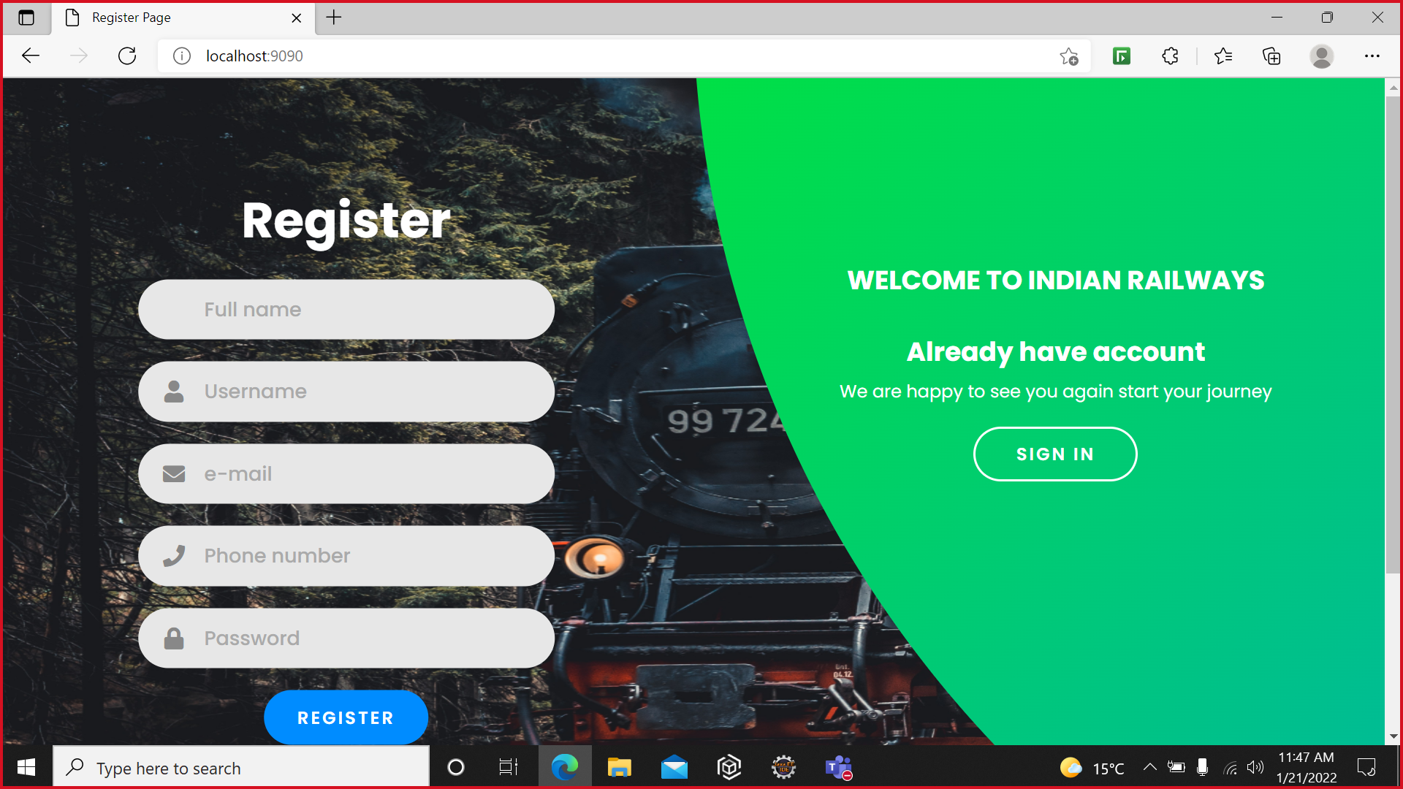

Slide 8
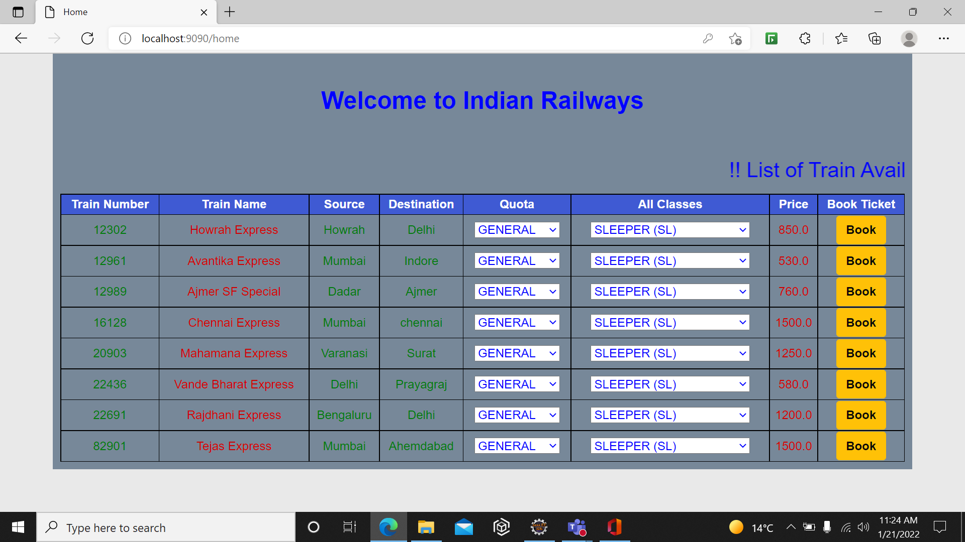

Slide 9
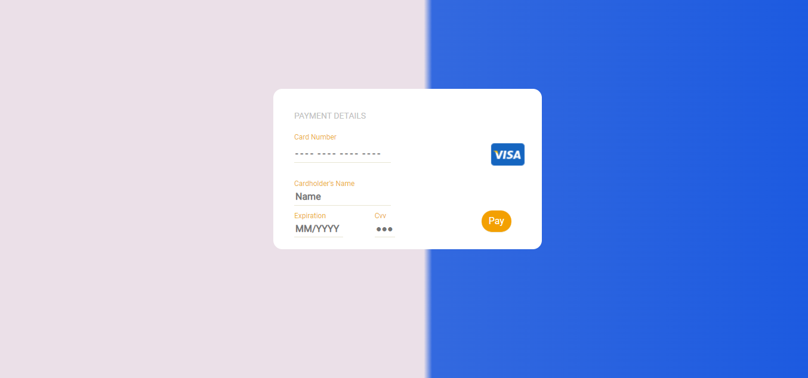
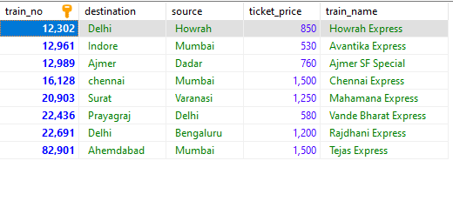
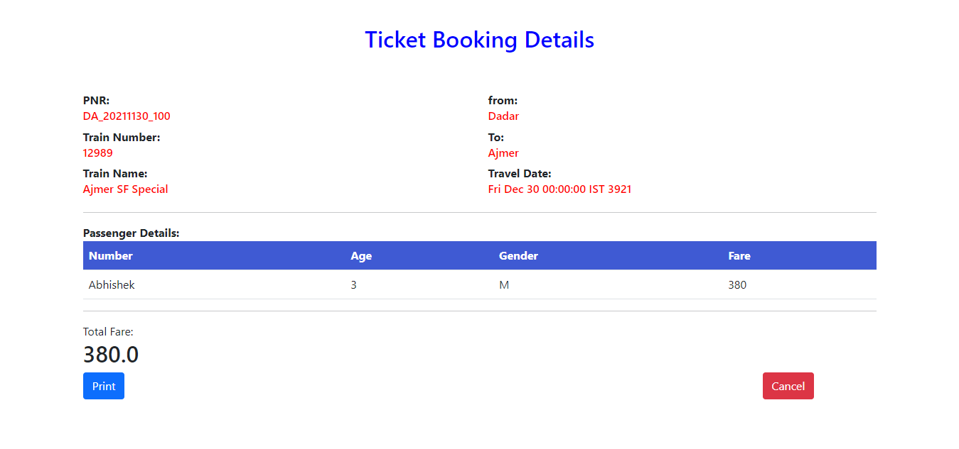
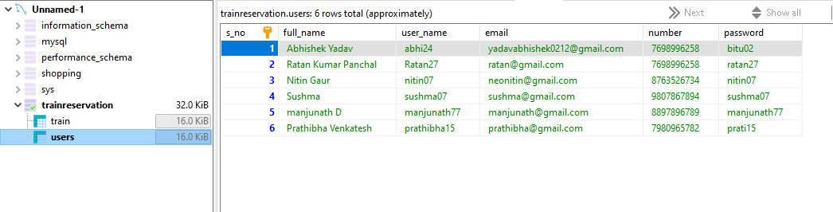

Slide 10
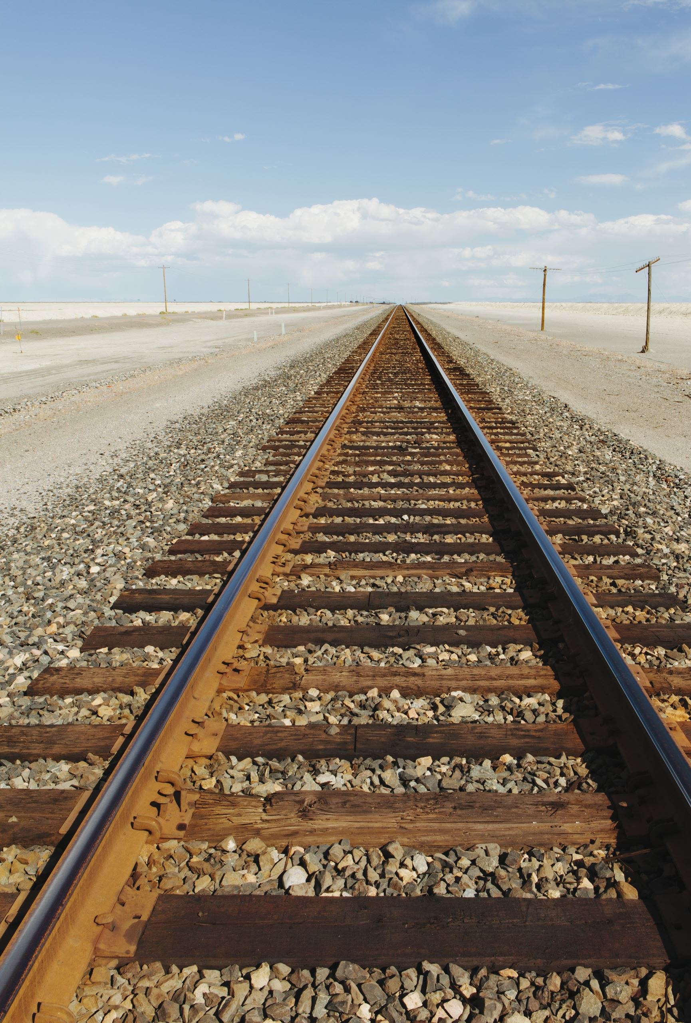
CONCLUSION
The Railway Ticket Reservation System is to Manage the Details of trains like train booking, timetable, ticket fares, station. Also, it manages all the information about passenger details.
The purpose of the project is to build an Application Program to Reduce the manual Work for managing and Booking the trains. As well it will help to avoid the manual errors.

Slide 11
THANK YOU

